Slide 1

Project Title -Healthcare Analytics for Doctor Visits
[Chandan Kumar Chandel]

Slide 2

PROBLEM STATEMENT
The healthcare industry continuously strives to improve patient care and operational efficiency through data-driven decision-making. This project, "Healthcare Analytics for Doctor Visits," aims to leverage data analytics to gain actionable insights into patient demographics, health conditions, and healthcare services utilization. By analyzing various aspects of the dataset, this project addresses several critical questions that can help healthcare providers optimize their services and improve patient outcomes.

Slide 3
Project Description
The "Healthcare Analytics for Doctor Visits" project uses data analysis to understand patient demographics, health issues, and how healthcare services are used. We'll look at how illnesses are spread among different groups, like men and women. We'll also study how people's income affects how often they go to the hospital. We'll check how many people have government or private health insurance. We'll also see how being sick affects daily life for men and women. By making sure the data is accurate and easy to understand, this project will help healthcare providers improve their services and take better care of patients.

Slide 4

WHO ARE THE END USERS?
The end users of the "Healthcare Analytics for Doctor Visits" project include healthcare providers such as hospitals, clinics, and healthcare administrators. They will benefit from the insights provided, which can help them optimize their services based on patient demographics, health conditions, and healthcare utilization patterns. Additionally, policymakers and healthcare analysts can use the findings to inform healthcare policies and improve overall healthcare delivery. Ultimately, the project aims to support better decision-making in healthcare management, leading to enhanced patient care and operational efficiency

Slide 5

Technology Used
In our "Healthcare Analytics for Doctor Visits" project, we're using Google Colab for advanced data analysis and Python coding in a cloud-based environment. It helps us handle large datasets and perform complex calculations collaboratively.
We're also using Microsoft Excel for basic data management and creating simple visualizations. Excel's user-friendly interface allows us to quickly clean data and present insights effectively.
These tools together support our goal of improving healthcare services by making informed decisions based on thorough data analysis.

Slide 6
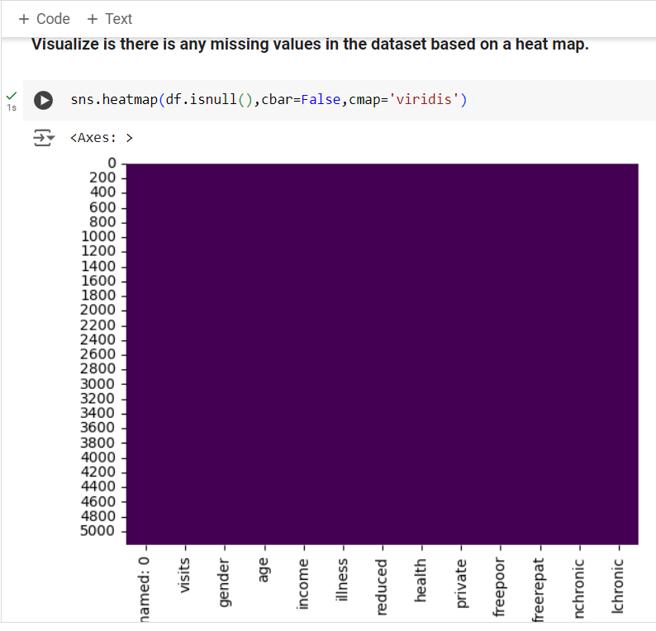
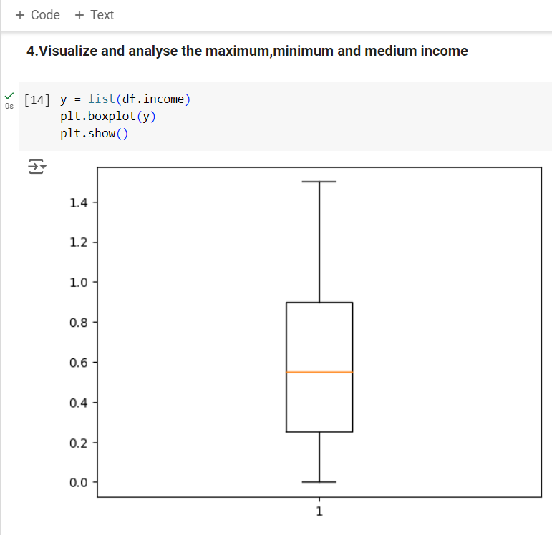
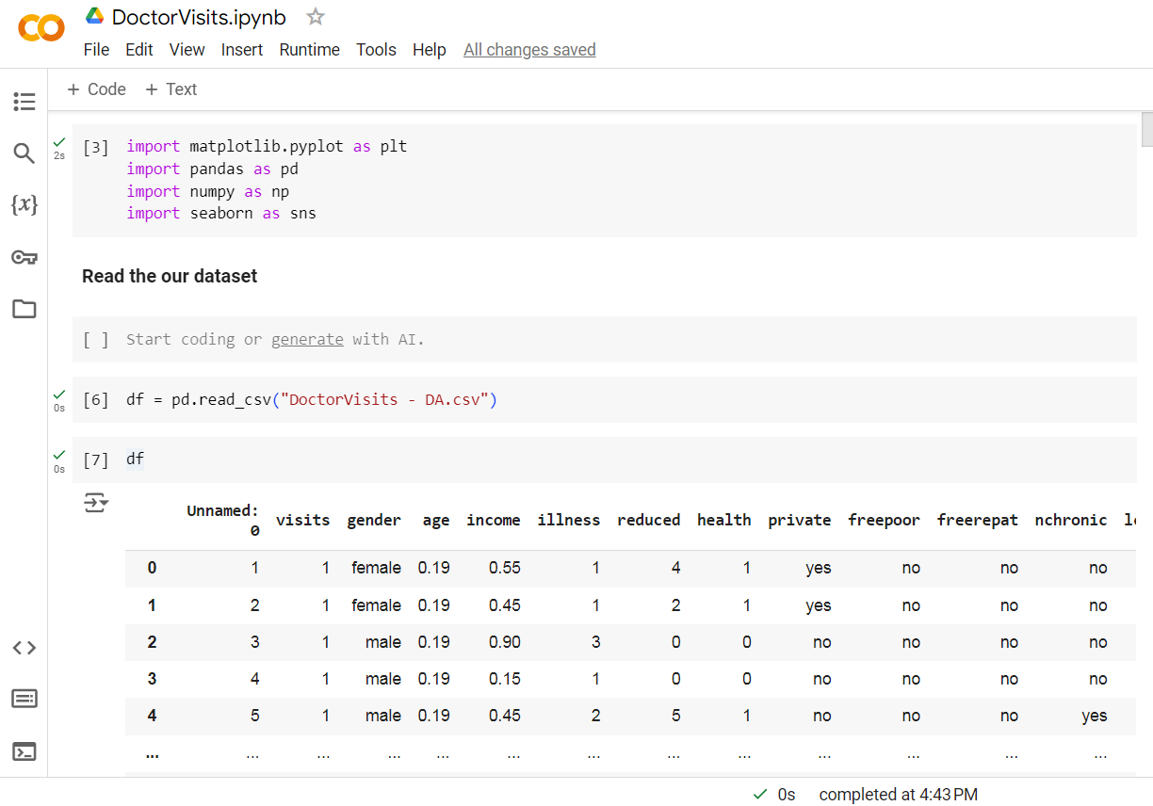
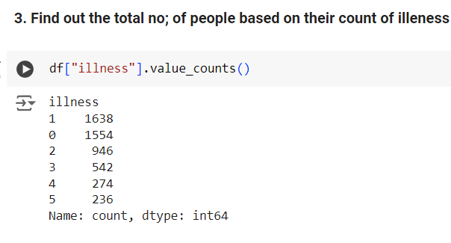
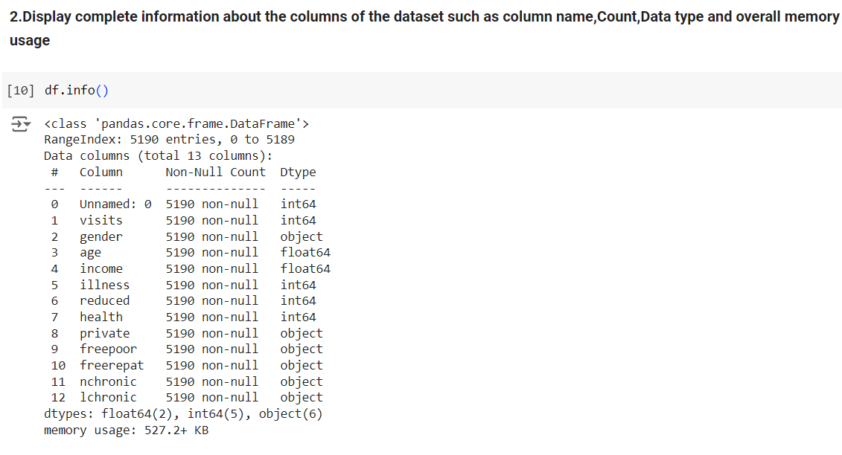
RESULTS
Demo Link

Slide 7
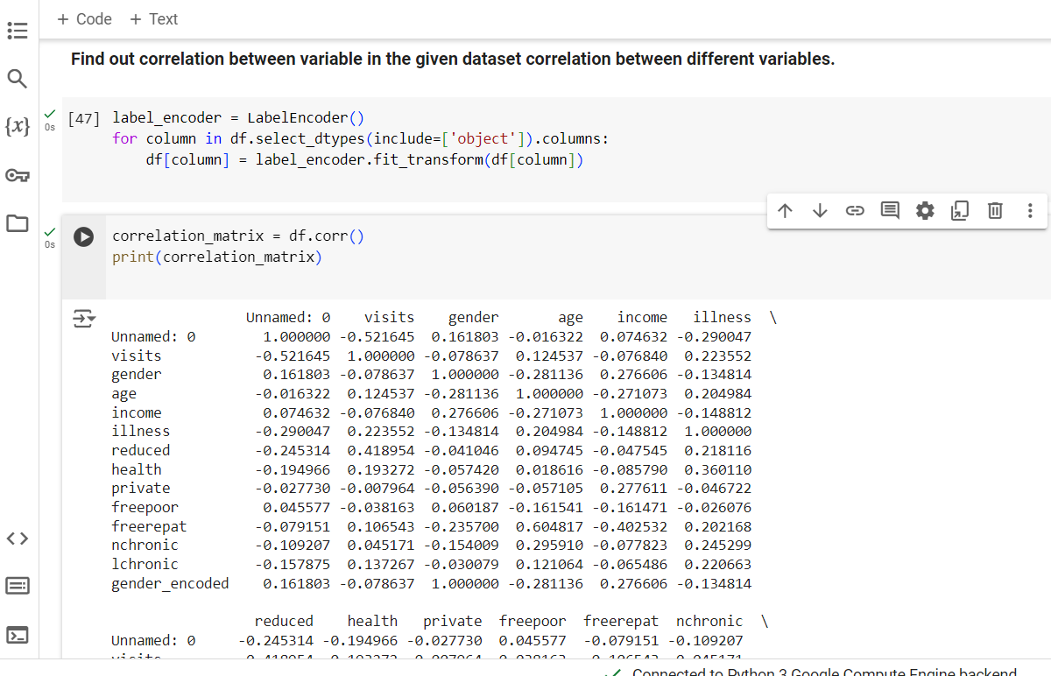
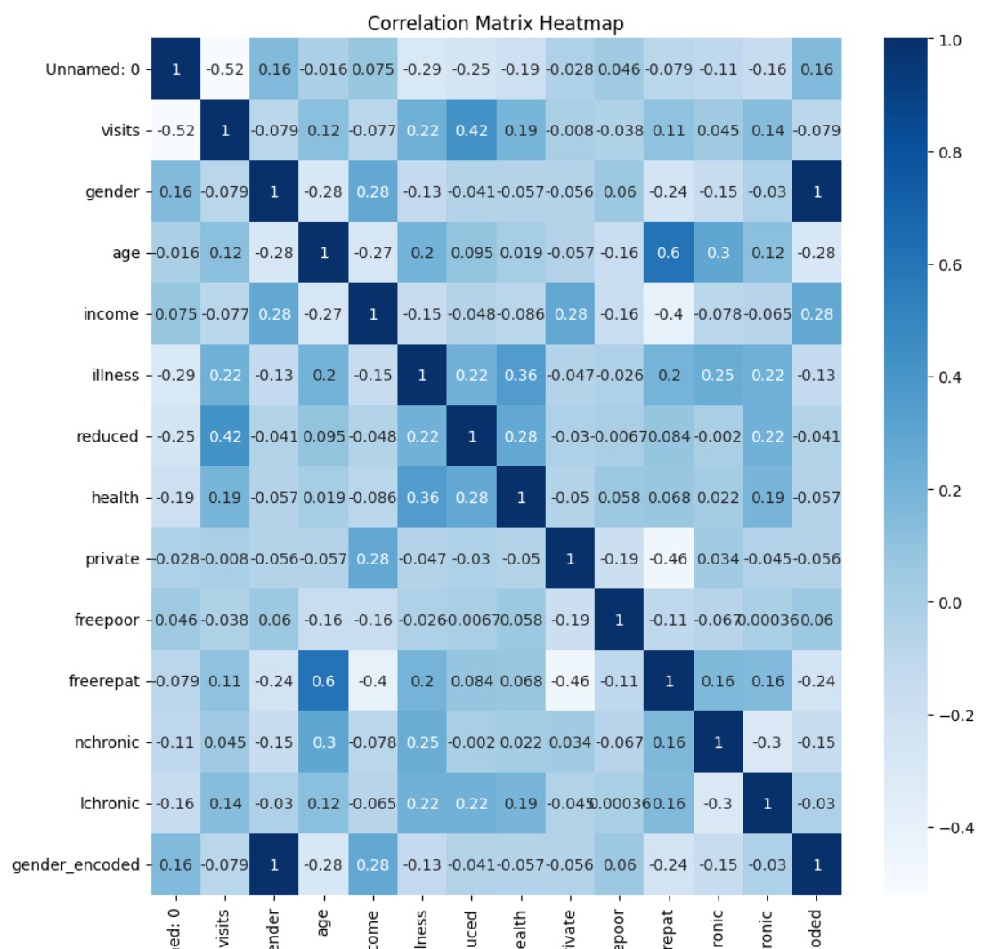
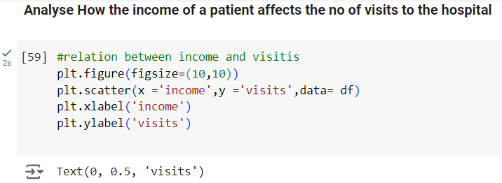
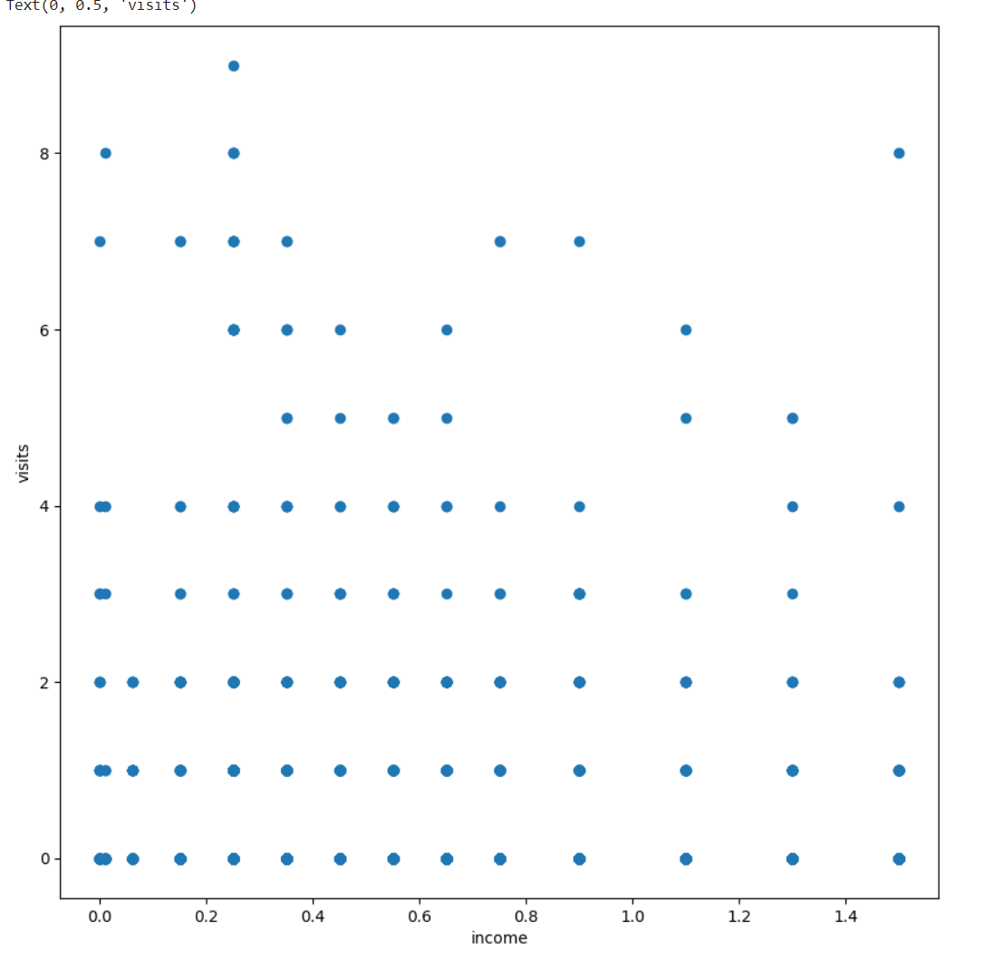
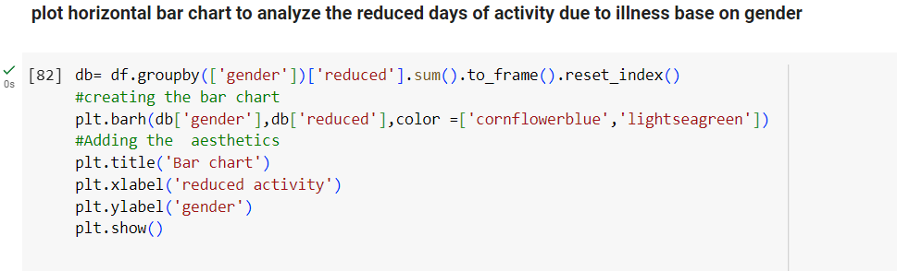
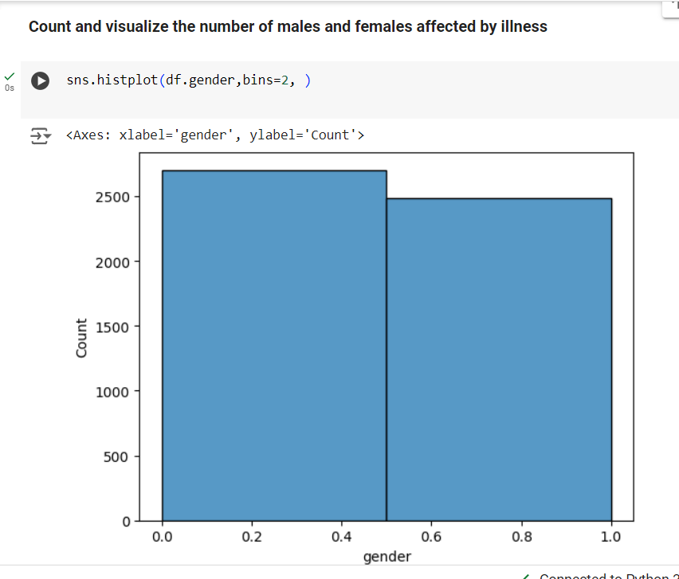
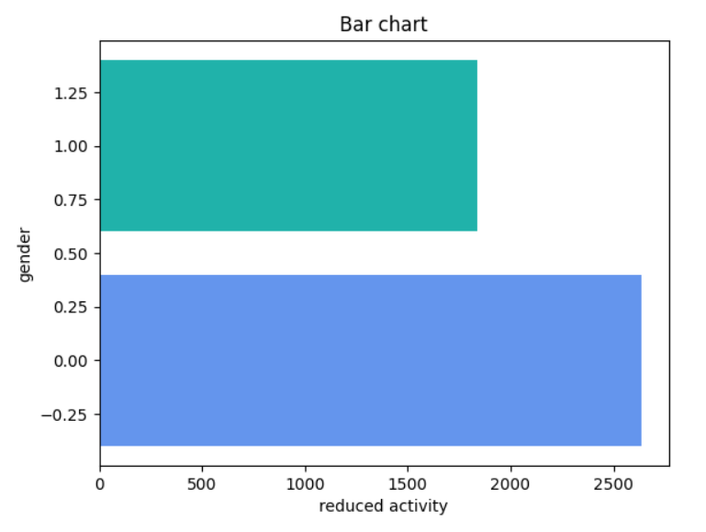
Result

Slide 8
Thank you
Thank you for your support and collaboration throughout the completion of this project
Chandan Kumar Chandel
.
.

